Slide 1
QUERY CLASSIFICATION -Kathan Patel

Slide 2
Project Outline
About the Project
Description of Data
Architecture of the Project
Code Explanation : i) Data Ambiguity
ii) Data Pre-Processing
iii) Model Selection
iv) Model Tuning
v) Prediction

Slide 3
About the Project
Problem Statement :
The goal of the query classification project is to build a Machine Learning model that classifies a query as attribute, spatial, or combination based on user Input.

Slide 4
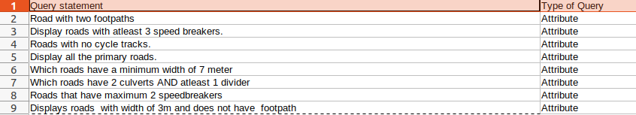
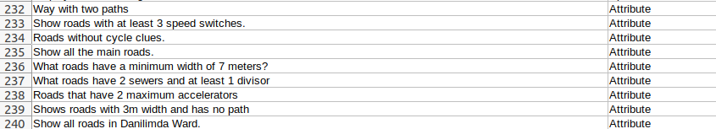
Description of Data

Slide 5

The Architecture of the Project
Data Cleaning
Exploratory Data Analysis
1
Text Preprocessing
2
Model Building
3
Evaluation
4
Improvement
5
Web Application
6
7

Slide 6
Data Cleaning
Rename Columns (Text,Target)
Label Encoding On Target Column
Check Missing Values
Check Duplicate Records

Slide 7
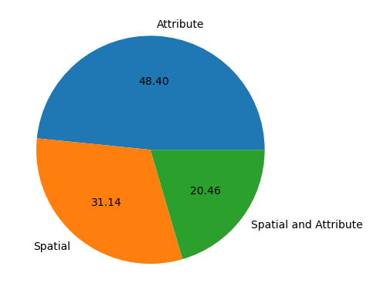
Exploratory Data Analysis(EDA)
Pie Chart :

Slide 8
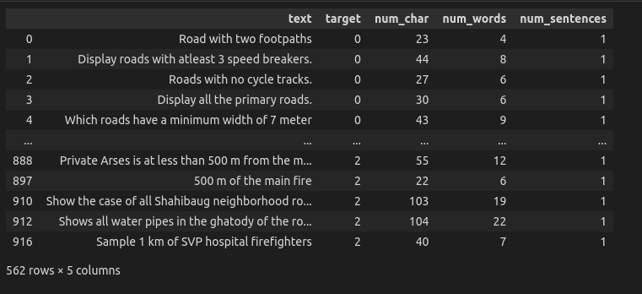
Feature Extraction From Existing Feature

Slide 9
Data Preprocessing
1.Lower Case
2.Tokenization
5.Stemming
3.Handle Special Characters
4.Handle Stop Words & Punctuation

Slide 10
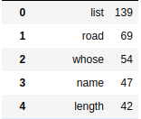
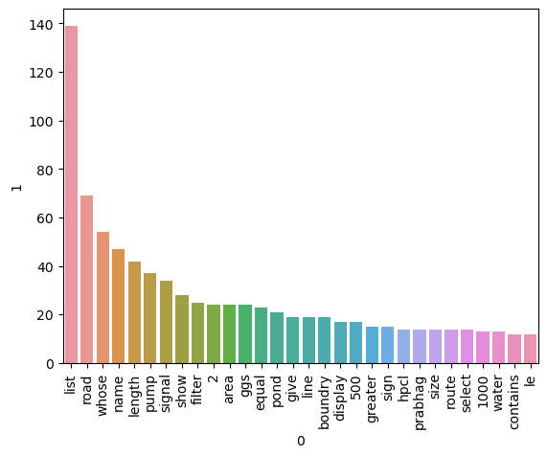
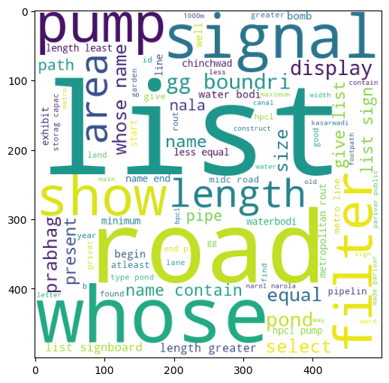
Find Most Repeating Words in Queries
Attribute

Slide 11
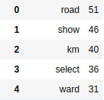
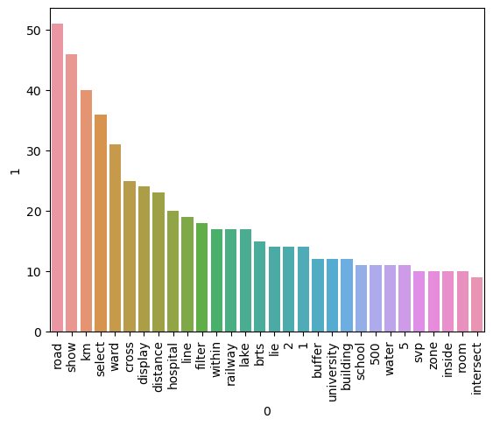
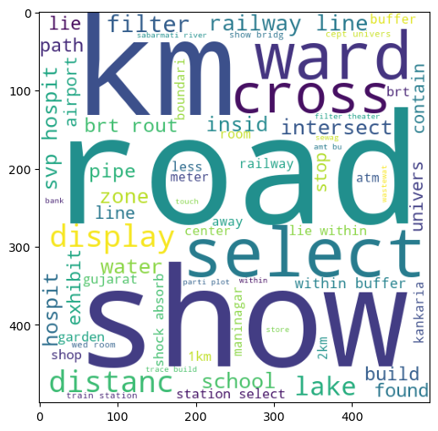
Spatial

Slide 12
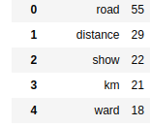
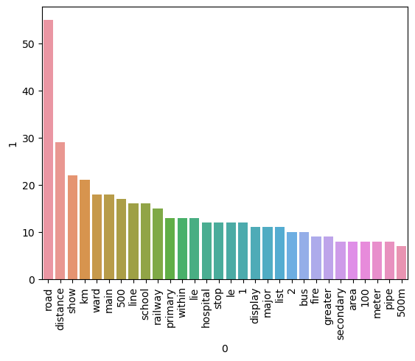
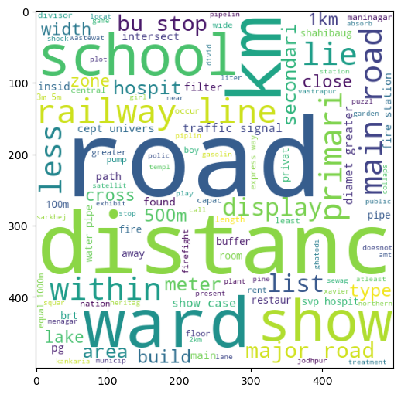
Combine

Slide 13
Text Vectorization
Bag Of Words
TF-IDF
Bag of N-Grams
Word2vec Word Embeddings

Slide 14
Model Training
Model Used :
LogisticRegression
SupportVectorClassifier
MultinomialNB
DecisionTreeClassifier
KNeighborsClassifier
RandomForestClassifier
AdaBoostClassifier
BaggingClassifier
ExtraTreesClassifier
GradientBoostingClassifier
XGBClassifier

Slide 15
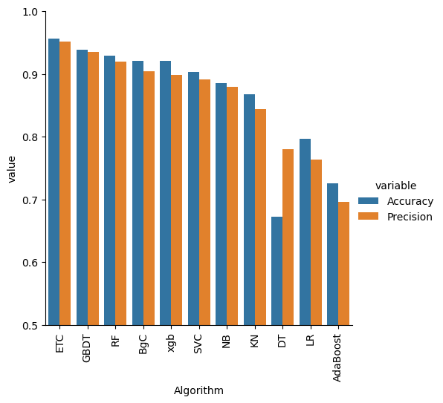
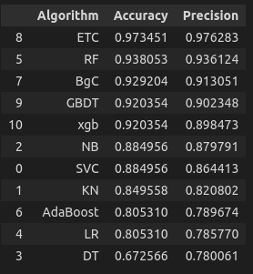
Evaluation

Slide 16
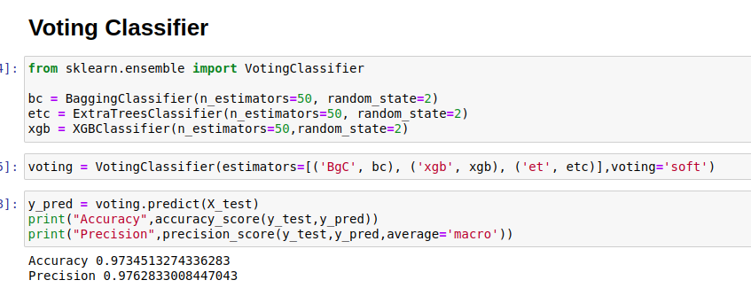
Ensemble Method

Slide 17
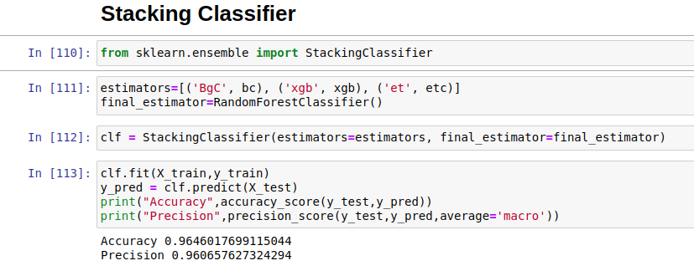

Slide 18
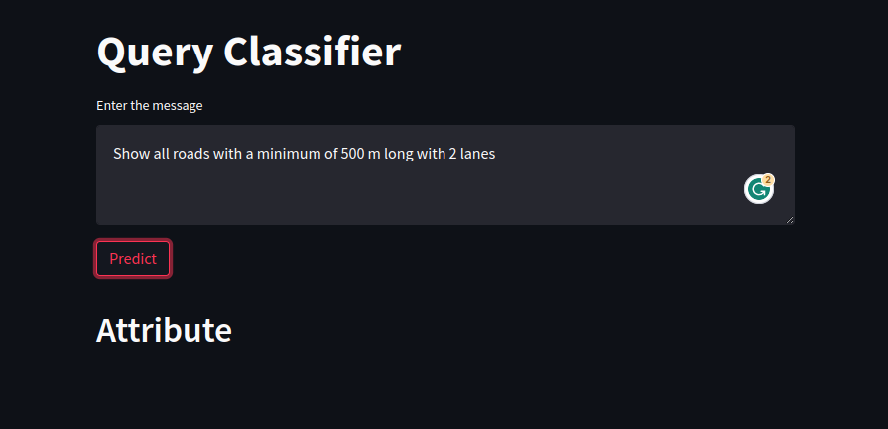
Prediction

Slide 19
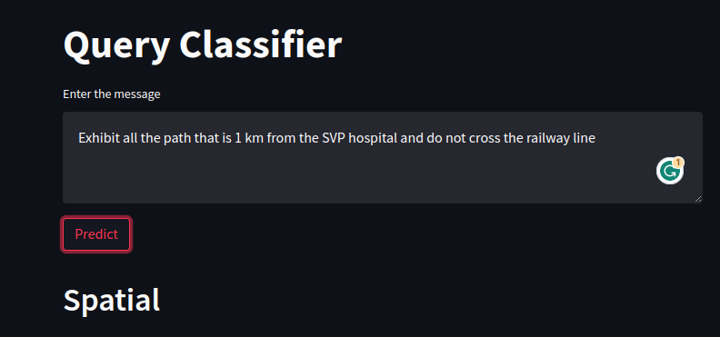

Slide 20
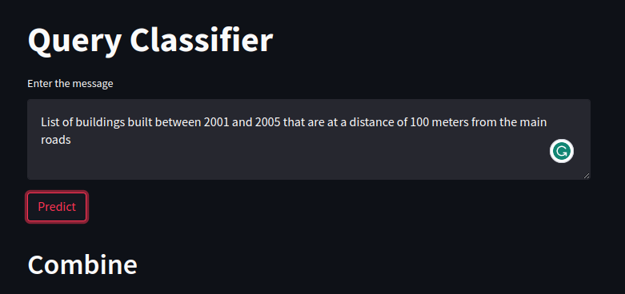

Slide 21
Thank You…

